Slide 1
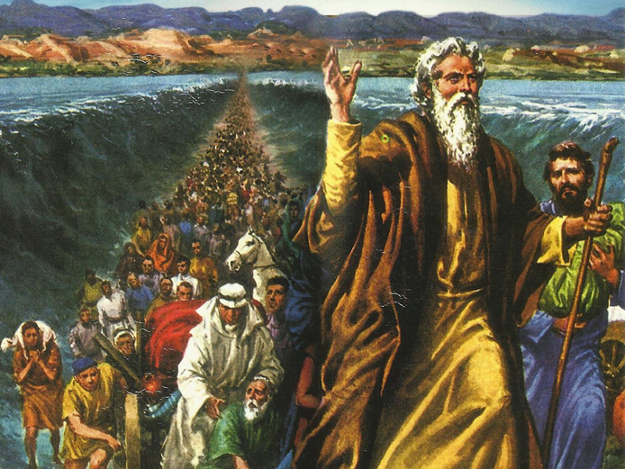
CATECHETICAL TEXTBOOK SERIES OF THE SYRO - MALABAR CHURCH
ON THE PATH OF SALVATION - 5
PEOPLE WHO AWAITED THE REDEEMER
5

Slide 2
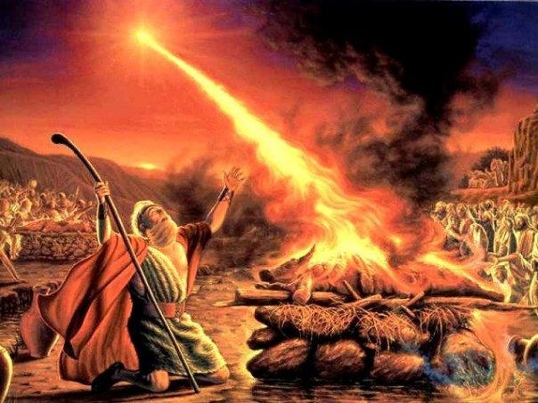
LESSON 12
PRAYERS AND SACRIFICES OF ISRAEL

Slide 3
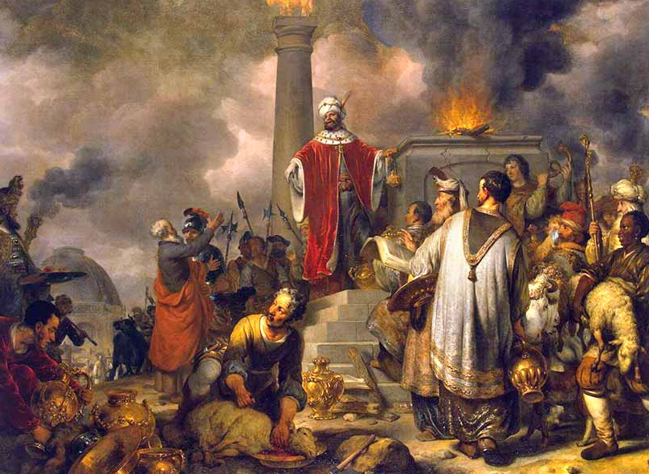
Prayer is conversation with God. Praise and worship to glorify God are also forms of prayer. Prayer includes our supplication to God as well. According to the Old testament, calling upon the name of God in itself is prayer. “ At that time people began to invoke the name of the Lord” (Gen.4:26). Even after building the alter for sacrifice, the patriarchs were also in the habit of invoking God’s name. Gen. 12:8;26:25). They also used to pray in private, individually. They prayed in the morning and in the evening (Deut. 6:4-6).

Slide 4
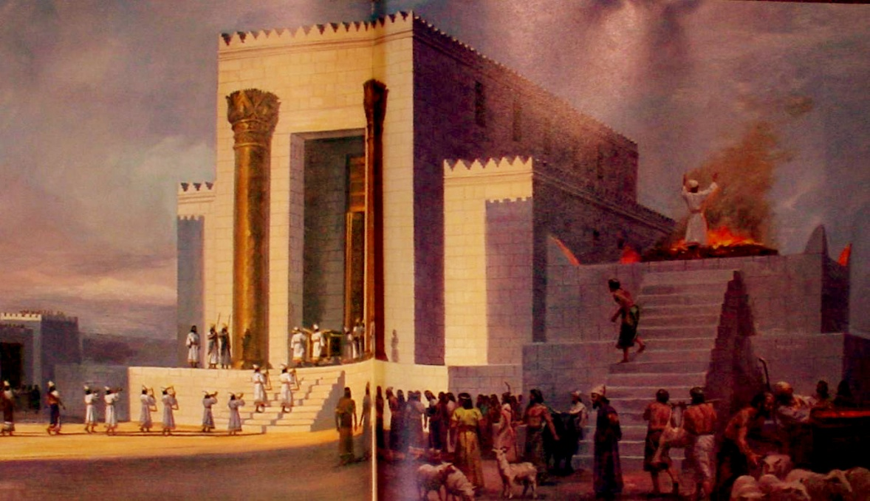
The temple
The art of the covenant was the symbol of the presence of God in the midst of the people of Israel. Having reached Canaan, they put up the ark in Gilgal. Later shifted to places like Bethel and Shiloh and was kept in a special tent or booth. Those places thus became the centres of worship. King David wished to erect a suitable temple to house the Ark of the Covenant. But it was Solomon the son of David who got God’s grace to accomplish the act of erecting a temple.

Slide 5
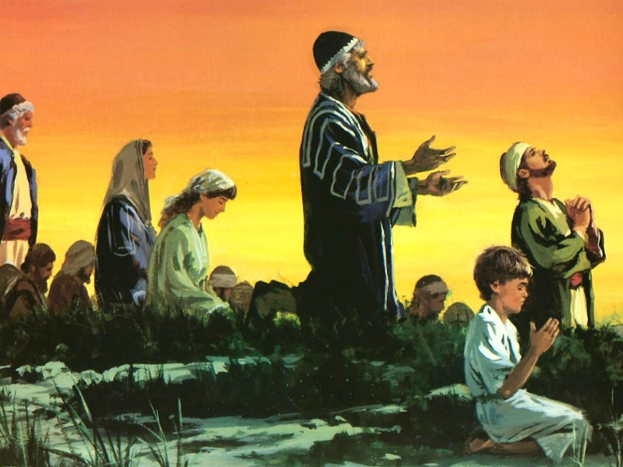
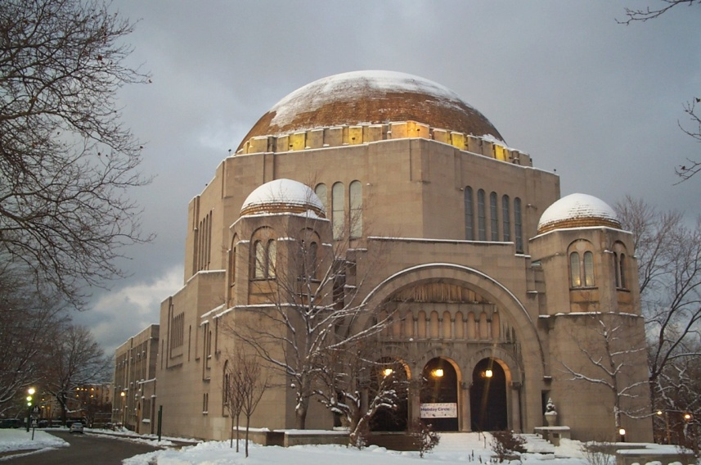
synagogue
For centuries, the temple of Jerusalem was the place of worship for the Israelites. In later years the Jew (Israelites) were exiled and they were not able to have the temple as the centre for worship. They had to to find other means to conduct their worship. It was at this stage that they built synagogues. The word synagogue is derived from the Greed word sunago meaning ‘get together’. Synagogues were built in a prominent place in the city or on a high place. These were built facing the holy city of Jerusalem.

Slide 6
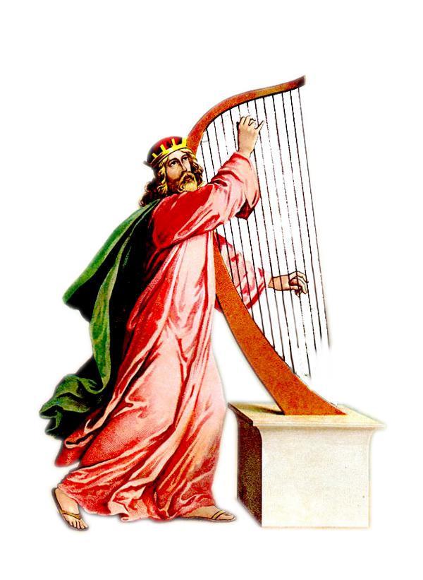
The psalms
The Psalms are hymns or prayer songs that were produced as a result of the special life-circumstances of the people of Israel. The Jews were in the habit of singing these psalms during festivals and pilgrimages. The psalms were composed in such a way that could be sung to the accompaniment of instruments or without them. It is believed that they were composed by king David. Some of them might have been written by someone else in David’s name.

Slide 7
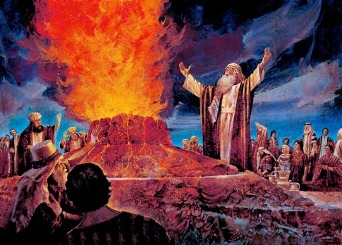
sacrifices
Right from the olden days, the people of Israel used to offer sacrifices to God. They offered sacrifices:
To praise and worship God,
To express thanks for the blessings from God,
To do penance for the sin committed,
To receive blessings from God.
When God gave the laws to Moses, particular directions regarding the offer of sacrifices were also given. Sacrifices were offered for the whole community, or for an individual. Sacrifices on the altar in the temple were offered by the priests.

Slide 8
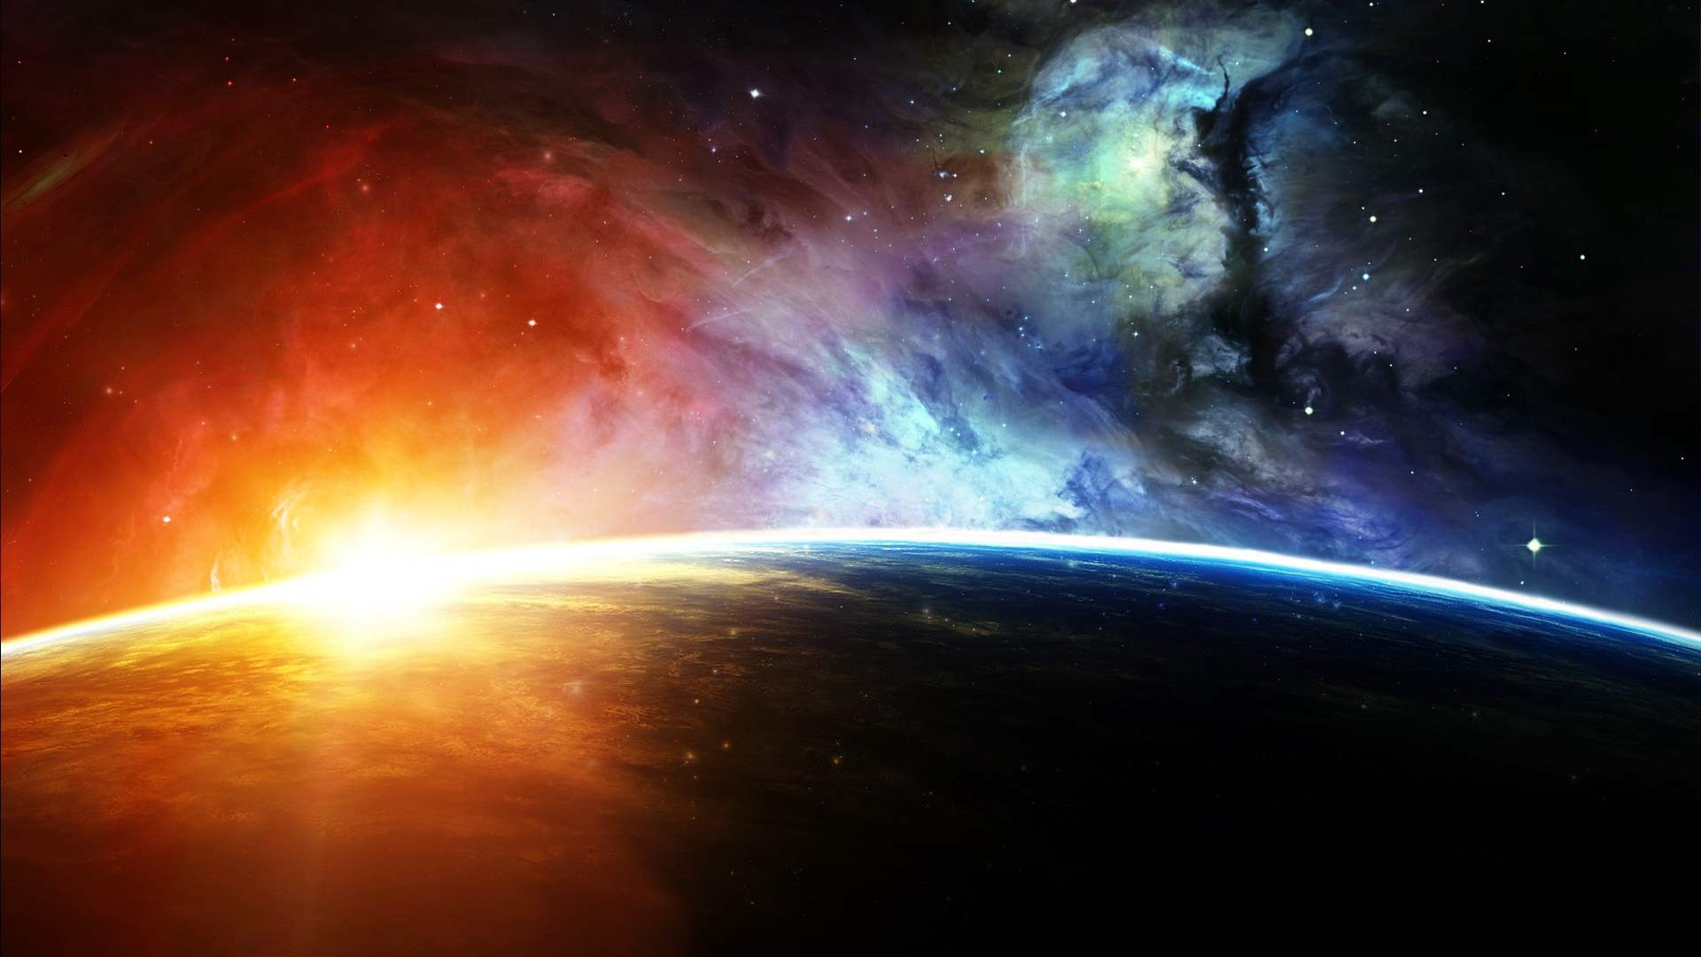
The observance of sabbath
The meaning of the Hebrew word Sabbath is to rest or to take a break. Taking a break from all sorts of work or labour. The day of Sabbath is to be spent in the service of God. The Israelites observed Sabbath on the seventh day of the week in remembrance of the seventh day rest God had taken after finishing the work of creation in six days.

Slide 9
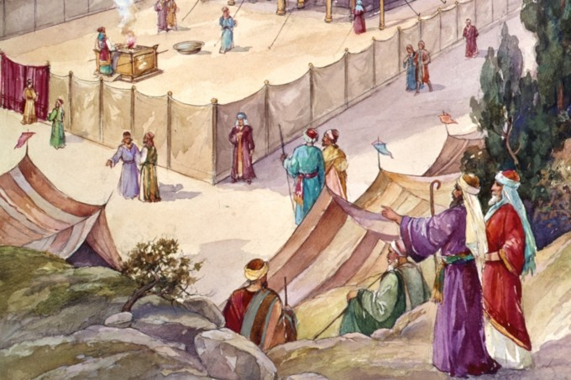
Jubilee celebration
Jubilee celebration is very important in the social life of Israel. After settling in Canaan, God commanded them that, after six years of sowing and reaping, they should observe the seventh year as Sabbath.
They year that follows a series of seven Sabbaths is the Jubilee year. The fiftieth year shall be the jubilee year for you. That should be holy for you (Lev.25: 11-12). God also gave special instructions on how to celebrate the jubilee. The jubilee celebrations reminded them that the land belongs to God, and brotherly relationship should exist among the people.

Slide 10
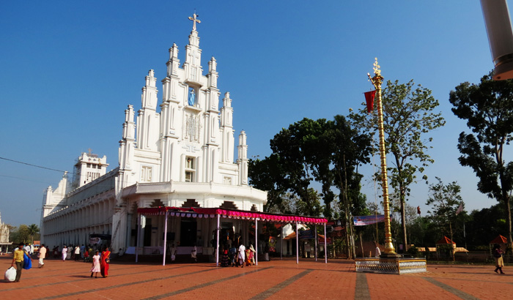
The churches and celebrations in the church
For the new people of God, the places of worship are known as the churches. These churches are the symbols of God’s presence. Holy Mass and other sacred rites are celebrated in the church. Those who join together in front of the altar of God are truly the people of God.

Slide 11
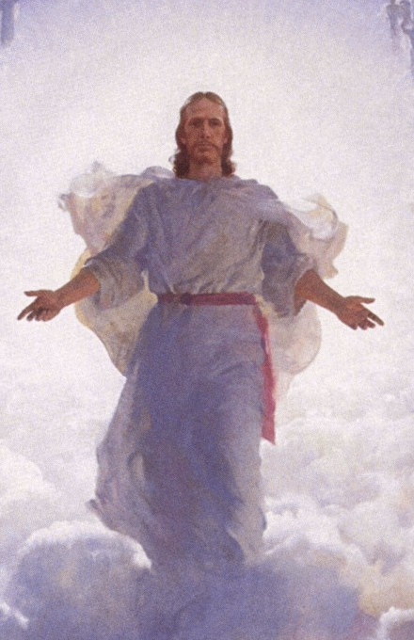
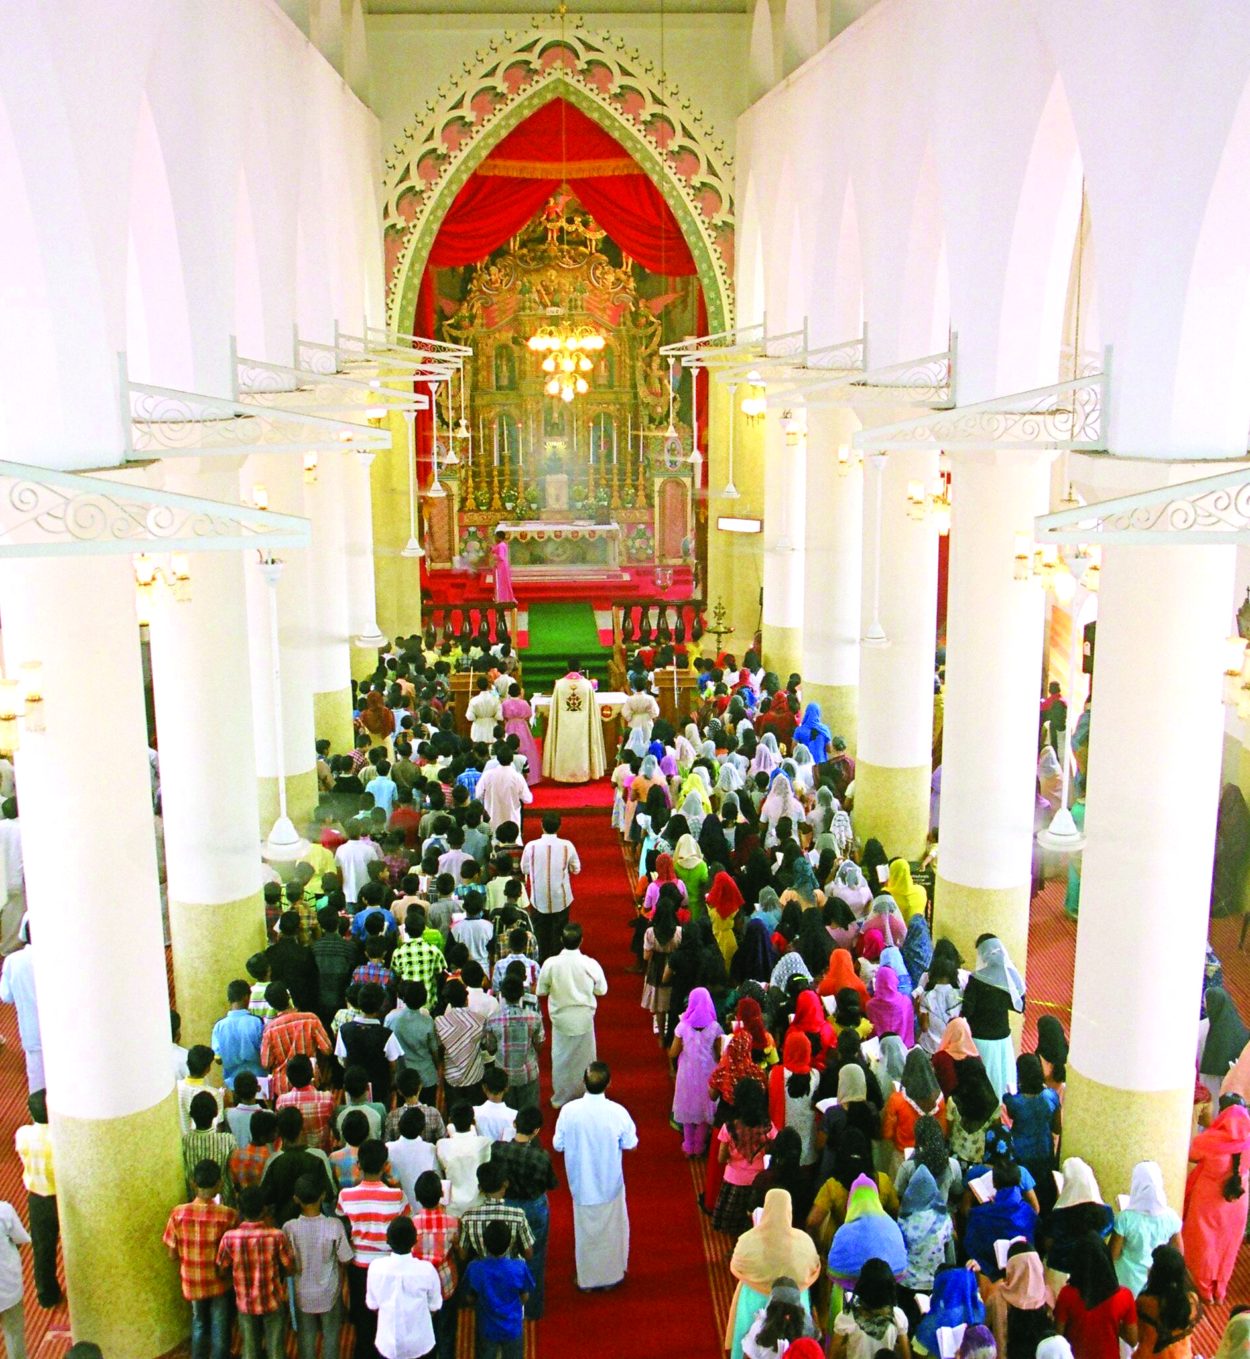
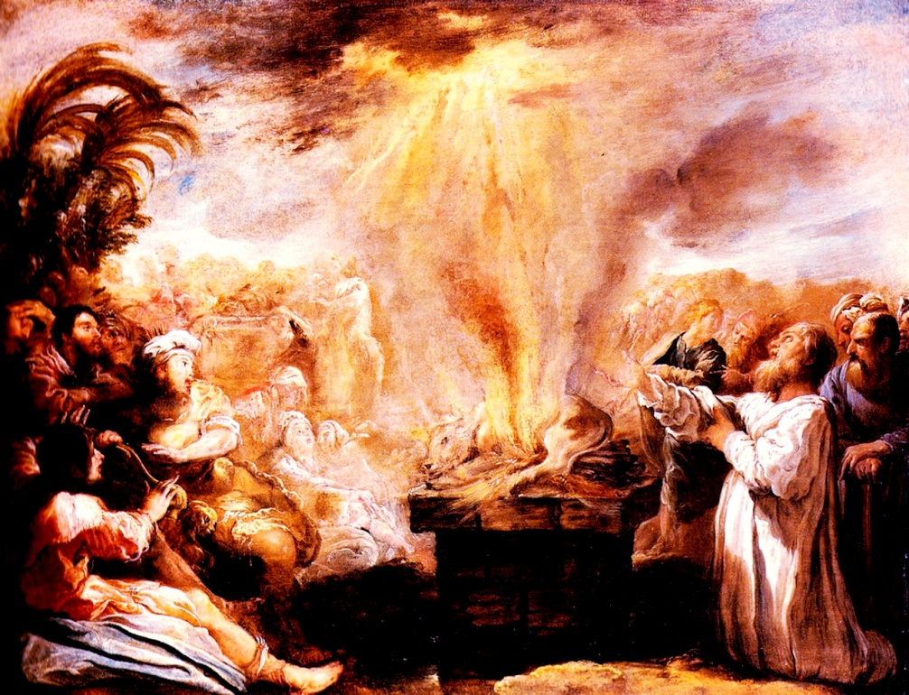
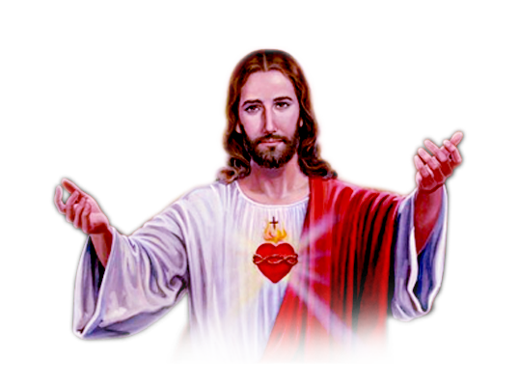
In the church, Sabbath is celebrated on Sunday, the first day of the week. The Christians observe Sunday as Sabbath because Jesus rose from the dead on a Sunday. Sunday is to be observed by attending Holy Mass in the parish church and involving in activities of charity. This is also the day to learn more about Jesus for the people of Israel, the temple, the sacrifice, the worship and prayer, all were symbols of their relationship with God. But Jesus gave a new meaning for all these. When we participate in the customary rites and rituals of the church, we shall be mature enough to obey the precepts of Jesus. Thus let us become true disciples of Jesus.

Slide 12
Let us pray
Almighty God, help us to behave reverently in the church and participate with piety in the Holy ceremonies.

Slide 13
READ AND RECOUNT
Narrate the event of the consecration of the temple at Jerusalem (1 kings. 8:22-53)

Slide 14

WORD OF GOD FOR GUIDANCE
“ Blessed are those who dwell in the house of God ” (Psalm. 84:4).

Slide 15
MY DECISION
Participating in the Holy mass, attending Sunday school and doing good to others, I will observe Sunday as a Holy day.

Slide 16
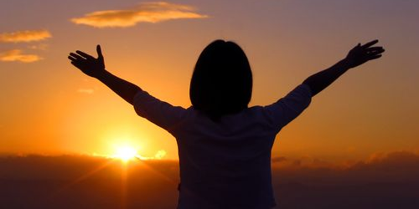

LET US DO
Write the first four sentences of psalm 84

Slide 17
LET US FIND OUT THE ANSWER
1. What is the importance of the temple of Jerusalem?
2. How did the name synagogue come into being?
3. On the basis of the content, how are the psalms divided?
4. What were the intentions for which the Israelites offered sacrifices?
5. How should we keep Sunday Holy?

Slide 18
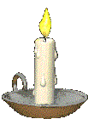


Thank you

